Slide 1

Healthcare/Pharma Data & Applications Final Presentation ALY6150
Group 1
Sneha Satheesha
Pranay Bindela
Craig Perkins

Slide 2

Predicting COVID-19 metrics in Massachusetts
Our group analyzed state level metrics for Covid-19 including:
Positive Tests
Deaths
Vaccines given
Hospitalizations
The group enriched the dataset with other sources to perform sub-group analysis on:
Age range
County-level case and death count
By year, by month and by quarter
Predictions were performed for:
New cases
Deaths
Hospitalizations

Slide 3

Presentation Outline
Executive Summary
Sourcing of the first dataset
Addition of supplementary datasets and combining data
Exploratory Data Analysis including summary statistics and data visualizations
Predictive Analytics
Conclusion

Slide 4

Executive Summary
The Covid-19 pandemic arrived in Massachusetts on February 1, 2020
There have been 1,942,303 total confirmed cases as of December 8, 2022
There have been 48,672,205 Covid-19 tests administered
There have been 20,972 deaths in total attributable to Covid-19
Middlesex county is currently leading the state with new confirmed cases at 1,566
Photo on the right is Marylou Sussers – the current secretary of Massachusetts Department of Health and Human Services

Slide 5

First Dataset
Pros:
The dataset contained all the features that the group wanted to make predictions on and analyze
Each row of the dataset corresponded to a day’s worth of metrics and all data is numeric
Opposed to data from mass.gov, the data since the onset was collected in one dataset opposed to having to build a scraper and parser to download weekly or daily reports to collect them into a single DataFrame
Cons:
The Covid-19 Tracking project stopped collecting data as of March 7, 2021
Data is aggregate to the state level making the dataset limited when performing sub-group analysis

Slide 6


SupplementAL Datasets
The NYTimes provides an open-source repository for COVID-19 data (https://github.com/nytimes/covid-19-data) that the group was able to enrich with for county-level daily counts of cases and deaths
Mass.gov provides the raw data that powers their tableau dashboard which contains useful snapshot data (https://www.mass.gov/info-details/covid-19-response-reporting)

Slide 7
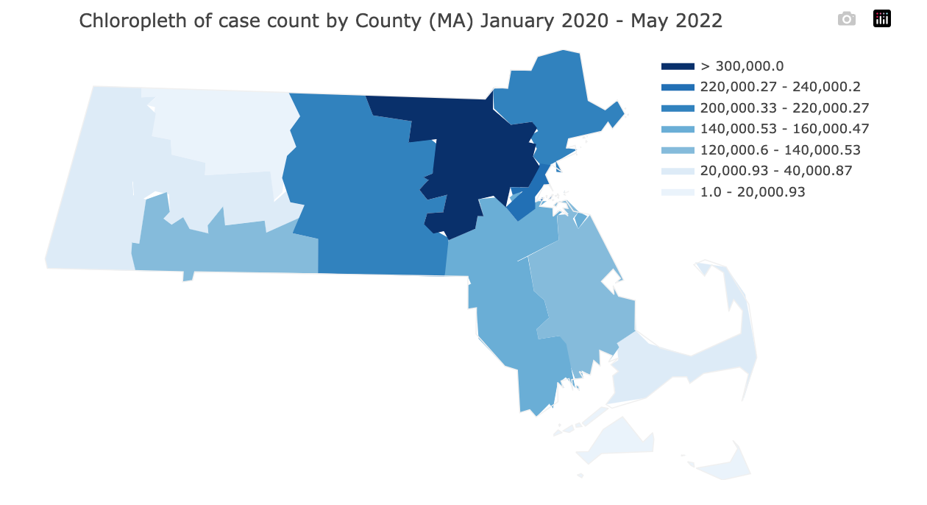
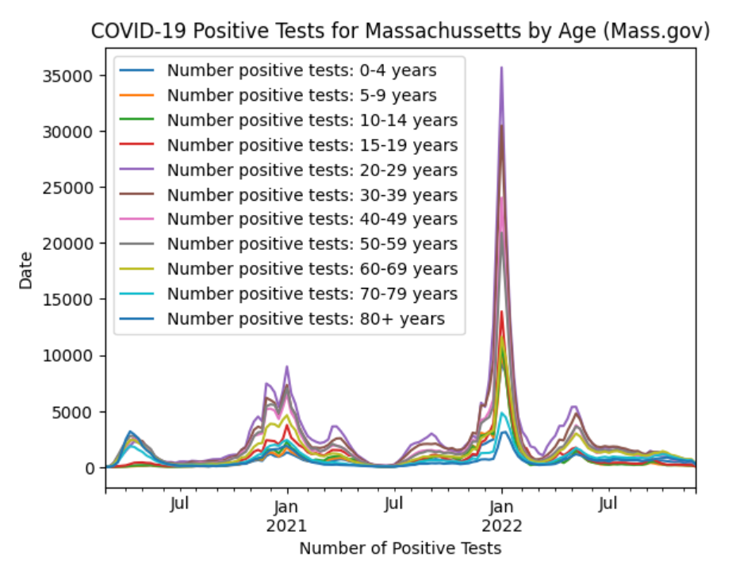
Exploratory Data Analysis
Features were removed from the dataset that were blank, duplicate or if they did not provide useful info for analysis
Missing values were imputed using KNNImputer
Visualizations were created to get an intuitive understanding of the data like how to identify waves of the COVID-19 virus
Summary statistics by sub-group were performed to identify more vulnerable sub-groups

Slide 8

Thank You

